Slide 1

GitHub Collaboration

Slide 2
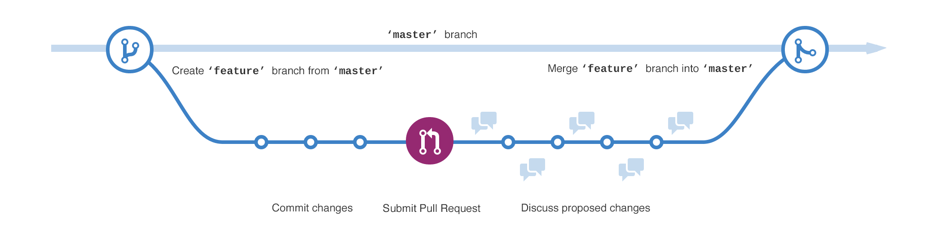
Branches
A branch is a parallel version of a repository
Branches allow developers to isolate development work, then merge it together

Slide 3

Merging
Merging takes the changes from one branch and applies them into another

Slide 4
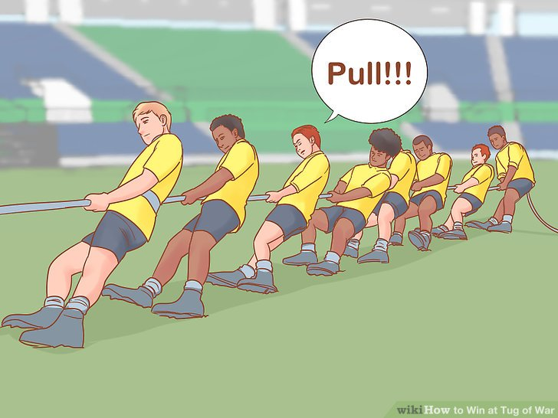

Pull Requests
Pull requests are proposed changes to a repository
You can use them to merge your feature branch changes into the master branch

Slide 5
Typical Workflow
Developer wants to work on a new feature in the repository
Developer creates a new feature branch in the repository
Developer pushes changes to the feature branch
Team makes changes in the master branch
Developer merges the master branch into the feature branch
Developer submits a pull request to the master branch
Team merges the feature branch into the master branch

Slide 6
Typical Workflow

Slide 7
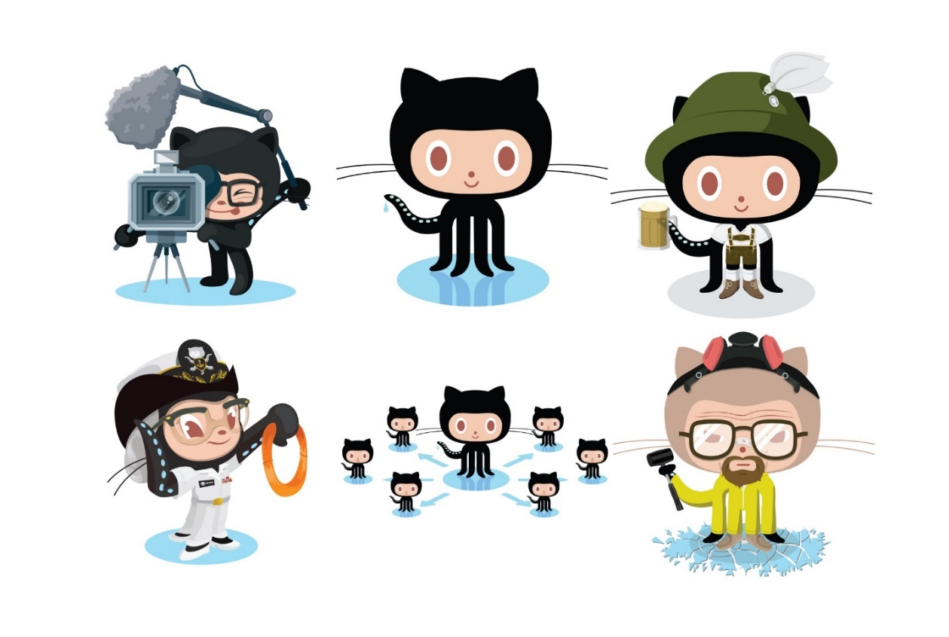
Practice
Play through this interactive tutorial to learn Git branching:
https://learngitbranching.js.org/

